Slide 1
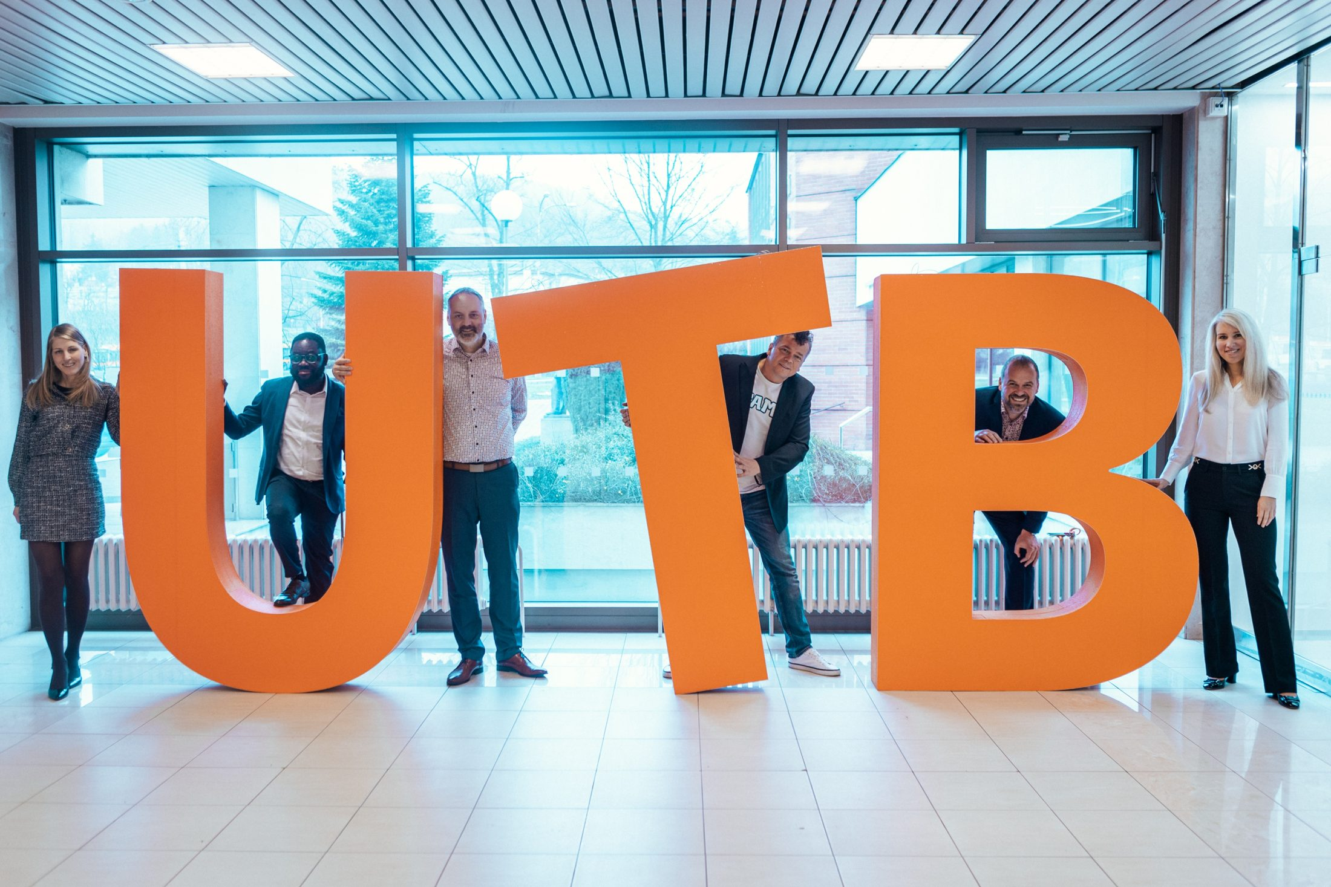
PROGRAMME OF THE CANDIDATE FOR RECTOR
prof. Ing. David Tuček, Ph.D.
A university for students, academics and the future — rooted in its community and region.
A strong university needs not only a strong rector, but a strong team.

Slide 2

ABOUT ME
My professional life
From student in Zlín to rector candidate — a career firmly tied to UTB.
TOMAS BATA UNIVERSITY IN ZLÍN
02 / 26

Slide 3
ABOUT ME
My professional life
From student in Zlín to rector candidate — a career firmly tied to UTB.
1998
Ing. — Technology and Management FT VUT Brno
2002
Ph.D. — Business Management and Economics FP VUT Brno
2003
Assistant Professor FaME UTB
2007
Assoc. Prof. — Business Management and Economics FaME UTB
2009–2015
Vice-Rector of UTB industry cooperation, social affairs
2016–2024
Dean of FaME UTB eight years leading the faculty
2021
Professor — Management and Economics PEF MENDELU Brno
2022–2024
Chair, Association of Deans of Economics Faculties
2024–
Vice-Dean for Strategic Development, FaME
TOMAS BATA UNIVERSITY IN ZLÍN
02 / 26

Slide 4




ABOUT ME
My professional life
From student in Zlín to rector candidate — a career firmly tied to UTB.
1998
Ing. — Technology and Management FT VUT Brno
EXPERTISE
2002
Ph.D. — Business Management and Economics FP VUT Brno
BPM
2003
Assistant Professor FaME UTB
Process modelling and improvement
2007
Assoc. Prof. — Business Management and Economics FaME UTB
Guarantor, MSc & PhD programmes
2009–2015
Vice-Rector of UTB industry cooperation, social affairs
Industrial engineering, ergonomics
2016–2024
Dean of FaME UTB eight years leading the faculty
2021
Professor — Management and Economics PEF MENDELU Brno
1 patent, 2 utility models
2022–2024
Chair, Association of Deans of Economics Faculties
Digitalisation and data
2024–
Vice-Dean for Strategic Development, FaME
TOMAS BATA UNIVERSITY IN ZLÍN
02 / 26

Slide 5
ABOUT ME
My professional life
From student in Zlín to rector candidate — a career firmly tied to UTB.
1998
Ing. — Technology and Management FT VUT Brno
EXPERTISE
2002
Ph.D. — Business Management and Economics FP VUT Brno
BPM
2003
Assistant Professor FaME UTB
Process modelling and improvement
2007
Assoc. Prof. — Business Management and Economics FaME UTB
Guarantor, MSc & PhD programmes
2009–2015
Vice-Rector of UTB industry cooperation, social affairs
Industrial engineering, ergonomics
2016–2024
Dean of FaME UTB eight years leading the faculty
2021
Professor — Management and Economics PEF MENDELU Brno
1 patent, 2 utility models
2022–2024
Chair, Association of Deans of Economics Faculties
Digitalisation and data
2024–
Vice-Dean for Strategic Development, FaME
My leadership credo
“The biggest mistake is not a late or flawed project. The biggest mistake is pretending nothing is happening.”
TOMAS BATA UNIVERSITY IN ZLÍN
02 / 26

Slide 6

CAREER
What I bring to the whole of UTB
TOMAS BATA UNIVERSITY IN ZLÍN
03 / 26

Slide 7
CAREER
What I bring to the whole of UTB
20+
10
130+
years at UTB
H - Index
scholarly publications
academic and managerial experience inside the university
research in management and industrial engineering
TOMAS BATA UNIVERSITY IN ZLÍN
03 / 26

Slide 8
CAREER
What I bring to the whole of UTB
20+
10
130+
years at UTB
H - Index
scholarly publications
academic and managerial experience inside the university
research in management and industrial engineering
40
40
13
Web of Science publications
Scopus publications
multidisciplinary projects
internationally visible results and research quality
helping keep UTB high in the Times Higher Education Rankings
national and international, as lead or co-investigator
TOMAS BATA UNIVERSITY IN ZLÍN
03 / 26

Slide 9
CAREER
Experience that carries responsibility
Values and strengths I want to put to work for all of UTB.
TOMAS BATA UNIVERSITY IN ZLÍN
04 / 26

Slide 10
CAREER
Experience that carries responsibility
Values and strengths I want to put to work for all of UTB.
INDUSTRIAL ENGINEERING + MANAGEMENT = a systemic view, clear strategy and respect for people.
WHAT I VALUE IN LEADERS
Strong management and communication skills, internally and externally.
The ability to connect people, data, technology and performance.
TOMAS BATA UNIVERSITY IN ZLÍN
04 / 26

Slide 11


CAREER
Experience that carries responsibility
Values and strengths I want to put to work for all of UTB.
INDUSTRIAL ENGINEERING + MANAGEMENT = a systemic view, clear strategy and respect for people.
WHAT I VALUE IN LEADERS
Strong management and communication skills, internally and externally.
The ability to connect people, data, technology and performance.
›
›
›
PEOPLE
DATA
TECHNOLOGY
PERFORMANCE
TOMAS BATA UNIVERSITY IN ZLÍN
04 / 26

Slide 12
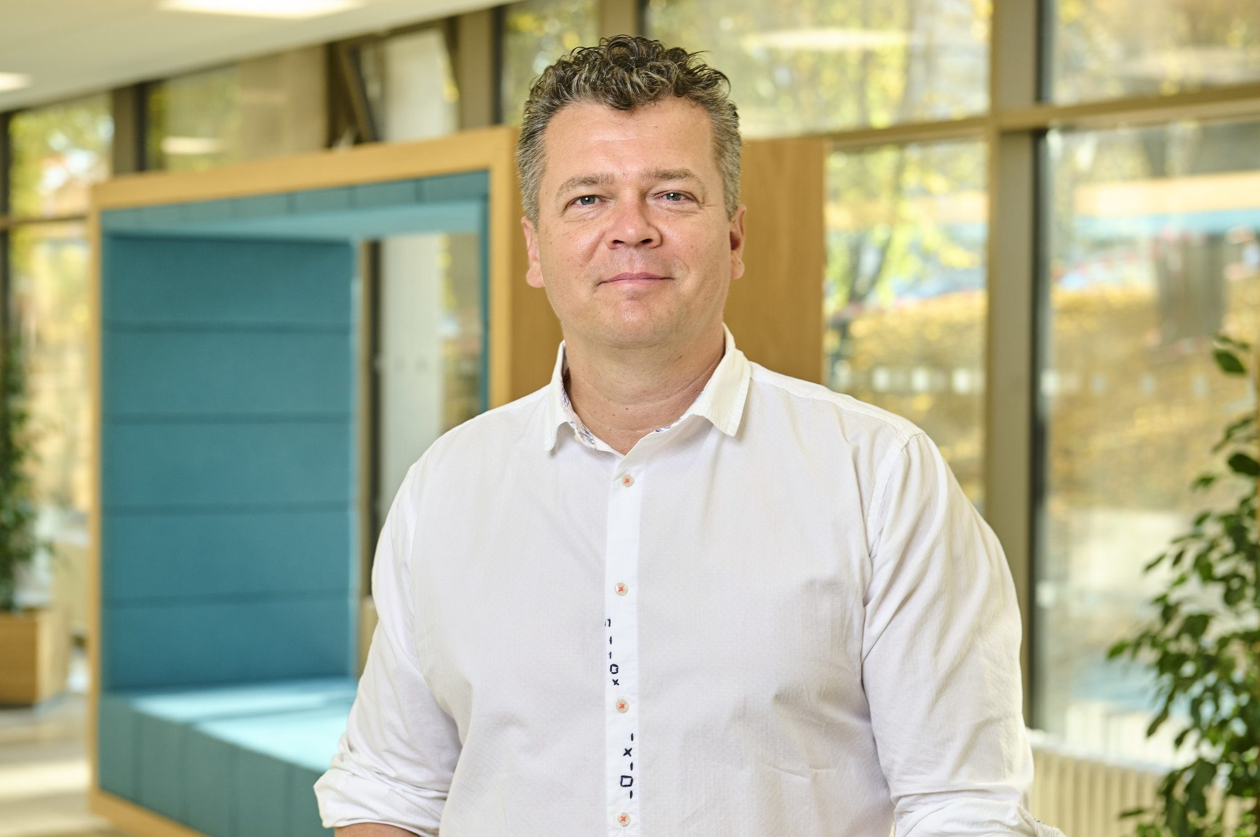
MOTIVATION
Why I want to lead UTB
My motivation comes from experience, responsibility to the university and the ambition to move it forward over the next four years.
TOMAS BATA UNIVERSITY IN ZLÍN
05 / 26

Slide 13

MOTIVATION
Why I want to lead UTB
My motivation comes from experience, responsibility to the university and the ambition to move it forward over the next four years.
Building teams
My principle in leading people: every success stands on a strong team.
Knowing the institution
I know UTB from the inside — one whole built on cooperation and respect.
TOMAS BATA UNIVERSITY IN ZLÍN
05 / 26

Slide 14

MOTIVATION
Why I want to lead UTB
My motivation comes from experience, responsibility to the university and the ambition to move it forward over the next four years.
Building teams
My principle in leading people: every success stands on a strong team.
Knowing the institution
I know UTB from the inside — one whole built on cooperation and respect.
Industry experience
A network of business contacts and scientific board memberships for partnerships and projects.
Growth strategy
Experience, continuity and the change needed for a confident, open UTB.
“What matters is not what they say when you arrive, but what they say when you leave.”
TOMAS BATA UNIVERSITY IN ZLÍN
05 / 26

Slide 15
UTB BENCHMARK
UTB benchmarked against selected Czech universities, 2025
Size · doctoral students · programmes · graduate employment · R&D · IP · housing · internationalisation · Horizon/HE
Indicator | TUL | UTB | ZČU | VŠB-TUO | VUT | UJEP | SU
Students Bc./Mgr. / Ph.D. | 6,046 / ≈400 | 9,288 / 351 | 11,306 / ≈650 | 12,087 / ≈1,000 | 16,360 / ≈1,700 | 8,413 / ≈300 | 5,365 / ≈100
Share of Ph.D. / all students | 6.20 % | 3.64 % | 5.44 % | 7.64 % | 9.41 % | 3.44 % | 1.83 %
Study programmes / graduate employment | 100+ / n/a | 120 / 98.5 % | 130 / n/a | 206 / n/a | 295 / 75 % in field | 100+ / n/a | 60+ / n/a
Institutional research evaluation (2021–2025) | B | C | B | C | A | B | C
Patent + utility model applications (2025) | 23 | 17 | 27 | 45 | 52 | n/a | n/a
International students in accredited programmes / share | 448 / 6.8 % | 1,175 / 12.6 % | 721 / 5.8 % | 1,760 / 12.9 % | 4,863 / 26.4 % | n/a | n/a
Horizon/HE projects (verified in CORDIS) | min. 5 | 1+ | 2+ | 3+ | 13 | 0+ | 0+
Horizon 2020 projects active in 2025 (CORDIS) | 0 | 2 | 0 | 2 | 7 | 0 | 0
Student housing (beds) / ratio to student numbers | 2,932 (+402) / 55 % | 1,159 (+141) / 13.5 % | 2,568 / 23 % | 2,803 / 23 % | approx. 2,700 / 17 % | 1,152 / 13.7 % | n/a
* Horizon/HE = publicly reported/verified minimum; n/a = no comparable public data found. Sources: MŠMT/SIMS 12/2024; MŠMT Research Organisation Evaluation 2025; Czech Industrial Property Office 2025; Study in Czechia; university and dormitory websites; UTB/VUT/ZČU/VŠB public data.
TOMAS BATA UNIVERSITY IN ZLÍN
06 / 26

Slide 16
UTB BENCHMARK
Conclusions for UTB
TOMAS BATA UNIVERSITY IN ZLÍN
07 / 26

Slide 17

UTB BENCHMARK
Conclusions for UTB
STUDENTS AND GRADUATES
9,288 Bc./Mgr. · 120 programmes · 351 Ph.D. — only 3.64 %!
98.5 % graduate employment · international students 12.6 %
TOMAS BATA UNIVERSITY IN ZLÍN
07 / 26

Slide 18

UTB BENCHMARK
Conclusions for UTB
STUDENTS AND GRADUATES
TRANSFER 2025
9,288 Bc./Mgr. · 120 programmes · 351 Ph.D. — only 3.64 %!
UTB CZK 12.7 m × VUT CZK 176.7 m
98.5 % graduate employment · international students 12.6 %
UTB 228 vs. VUT 1,181 contracts
TOMAS BATA UNIVERSITY IN ZLÍN
07 / 26

Slide 19

UTB BENCHMARK
Conclusions for UTB
STUDENTS AND GRADUATES
TRANSFER 2025
SPIN-OFF / START-UP
9,288 Bc./Mgr. · 120 programmes · 351 Ph.D. — only 3.64 %!
UTB CZK 12.7 m × VUT CZK 176.7 m
Room for systemic change
98.5 % graduate employment · international students 12.6 %
UTB 228 vs. VUT 1,181 contracts
UTB: 0 companies · VUT 2024: 4 → 2025: 7 companies
TOMAS BATA UNIVERSITY IN ZLÍN
07 / 26

Slide 20

UTB BENCHMARK
Conclusions for UTB
STUDENTS AND GRADUATES
TRANSFER 2025
SPIN-OFF / START-UP
TAKEAWAYS FOR R&D
9,288 Bc./Mgr. · 120 programmes · 351 Ph.D. — only 3.64 %!
UTB CZK 12.7 m × VUT CZK 176.7 m
Room for systemic change
Horizon Europe consortia — higher R&D quality
98.5 % graduate employment · international students 12.6 %
UTB 228 vs. VUT 1,181 contracts
UTB: 0 companies · VUT 2024: 4 → 2025: 7 companies
More PhD students, and with them more capacity for talent and spin-offs.
The benchmark confirms the need to aim for higher international research quality, strategic consortia and more PhD students, and with them talent capacity, professional tech transfer and a spin-off pipeline.
TOMAS BATA UNIVERSITY IN ZLÍN
07 / 26

Slide 21
UTB POSITION ANALYSIS
UTB SWOT analysis
TOMAS BATA UNIVERSITY IN ZLÍN
08 / 26

Slide 22


UTB POSITION ANALYSIS
UTB SWOT analysis
Strengths
Weaknesses
The Baťa tradition
Graduate employment 98.5 %
Expert excellence — CPS, CEBIA-Tech
Cooperation ecosystem (UPPER, PIONEER, Meet Up)
Weaker bibliometric profile vs. CZ/EU
University size vs. critical mass of R&D teams
Need for internationalisation and data integration
Few leisure activities for students and staff
TOMAS BATA UNIVERSITY IN ZLÍN
08 / 26

Slide 23


UTB POSITION ANALYSIS
UTB SWOT analysis
Strengths
Weaknesses
The Baťa tradition
Graduate employment 98.5 %
Expert excellence — CPS, CEBIA-Tech
Cooperation ecosystem (UPPER, PIONEER, Meet Up)
Weaker bibliometric profile vs. CZ/EU
University size vs. critical mass of R&D teams
Need for internationalisation and data integration
Few leisure activities for students and staff
Opportunities
Threats
Community university — identity of the region
AI and digitalisation
International strategic partnerships
Investment in campus and services for attractiveness
Demographics; competition at home and abroad
Performance funding; reputational risk of evaluations
Cyber and security threats
Brain drain, limited public budgets
TOMAS BATA UNIVERSITY IN ZLÍN
08 / 26

Slide 24
PROGRAMME
Eight pillars for UTB 2026–2030
A programme of balanced development for students, academics, staff, the region, partners and the community.
TOMAS BATA UNIVERSITY IN ZLÍN
09 / 26
Notes:
„Teď si pojďme říct, jak můžeme UTB v následujících čtyřech letech posunout dál – jak stavět na našich silných stránkách, využít příležitosti, systematicky odstraňovat slabá místa a současně omezovat dopady hrozeb. Z této logiky vycházejí hlavní pilíře navrhované strategie.“

Slide 25
PROGRAMME
Eight pillars for UTB 2026–2030
A programme of balanced development for students, academics, staff, the region, partners and the community.
1
2
3
4
A quality university for students
A university for academics and staff
Research excellence and doctoral studies
AI, digitalisation and a secure university
TOMAS BATA UNIVERSITY IN ZLÍN
09 / 26

Slide 26


PROGRAMME
Eight pillars for UTB 2026–2030
A programme of balanced development for students, academics, staff, the region, partners and the community.
1
2
3
4
A university for academics and staff
A quality university for students
Research excellence and doctoral studies
AI, digitalisation and a secure university
5
6
7
8
Entrepreneurial UTB and knowledge transfer
Strategic internationalisation
Sustainable UTB and the third mission
Transparent governance, finance and investment
TOMAS BATA UNIVERSITY IN ZLÍN
09 / 26

Slide 27
PILLAR 1 · COMMITMENTS TO 2030
A university for academics and staff
A strong university is built by motivated, respected people who keep growing professionally.
TOMAS BATA UNIVERSITY IN ZLÍN
10 / 26

Slide 28
PILLAR 1 · COMMITMENTS TO 2030
A university for academics and staff
A strong university is built by motivated, respected people who keep growing professionally.
Careers and evaluation
Evaluate teaching, research, supervision, transfer and service to the university in balance.
Reward quality teaching and project work transparently.
Retain young talent, extend the HR Award.
Fair evaluation of work
TOMAS BATA UNIVERSITY IN ZLÍN
10 / 26

Slide 29

PILLAR 1 · COMMITMENTS TO 2030
A university for academics and staff
A strong university is built by motivated, respected people who keep growing professionally.
Careers and evaluation
Less bureaucracy
Evaluate teaching, research, supervision, transfer and service to the university in balance.
Reward quality teaching and project work transparently.
Retain young talent, extend the HR Award.
Reduce the administrative burden — remove duplication.
Process support through IS/ICT and AI, measuring time saved.
Share best practice across faculties.
Fair evaluation of work
More efficient processes
TOMAS BATA UNIVERSITY IN ZLÍN
10 / 26

Slide 30

PILLAR 1 · COMMITMENTS TO 2030
A university for academics and staff
A strong university is built by motivated, respected people who keep growing professionally.
Careers and evaluation
Less bureaucracy
A safe environment
Evaluate teaching, research, supervision, transfer and service to the university in balance.
Reward quality teaching and project work transparently.
Retain young talent, extend the HR Award.
Reduce the administrative burden — remove duplication.
Process support through IS/ICT and AI, measuring time saved.
Share best practice across faculties.
Strengthen social safety, wellbeing and equal opportunities.
Support returns from parental leave.
Build a culture of respect, trust and open communication.
Fair evaluation of work
More efficient processes
Pride in the UTB brand
TOMAS BATA UNIVERSITY IN ZLÍN
10 / 26

Slide 31

PILLAR 2 · COMMITMENTS TO 2030
A quality university for students
Students as partners in shaping teaching, services and university life.
TOMAS BATA UNIVERSITY IN ZLÍN
11 / 26

Slide 32
PILLAR 2 · COMMITMENTS TO 2030
A quality university for students
Students as partners in shaping teaching, services and university life.
Community, campus, family
Support student societies, culture, sport and wellbeing; develop the student club and sports hall; give students a voice on university boards.
Successful progression through studies
Connect tutoring, mentoring, induction and counselling with the Job Centre; digital support for teaching.
TOMAS BATA UNIVERSITY IN ZLÍN
11 / 26

Slide 33

PILLAR 2 · COMMITMENTS TO 2030
A quality university for students
Students as partners in shaping teaching, services and university life.
Community, campus, family
Support student societies, culture, sport and wellbeing; develop the student club and sports hall; give students a voice on university boards.
Successful progression through studies
Connect tutoring, mentoring, induction and counselling with the Job Centre; digital support for teaching.
Quality, flexible study
Up-to-date, attractive programmes that respond to practice, shaped by student and employer feedback.
Students in projects and companies
Involve students in research teams and real briefs from companies, cities and hospitals — linked with the Czech Management Association.
Ambition for 2030: managed growth in student numbers while maintaining quality and completion rates.
TOMAS BATA UNIVERSITY IN ZLÍN
11 / 26

Slide 34
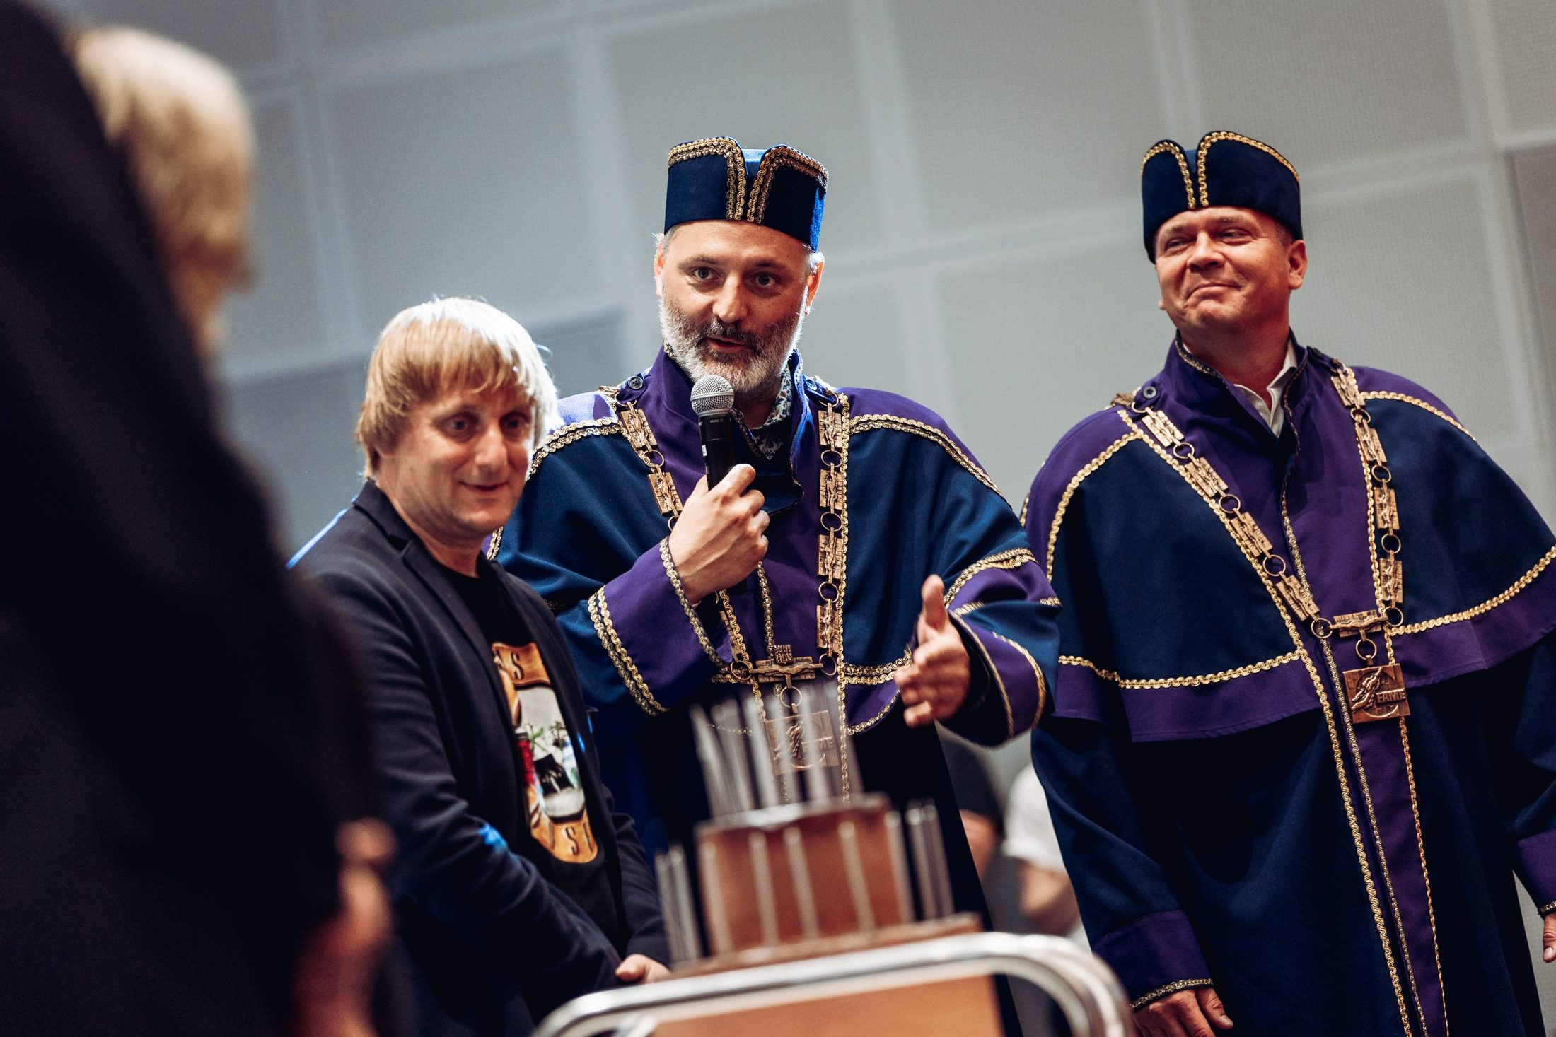
PILLAR 3 · COMMITMENTS TO 2030
Research excellence, doctoral studies and open science
Focus on areas where UTB can be scientifically respected and useful to society.
TOMAS BATA UNIVERSITY IN ZLÍN
12 / 26

Slide 35
PILLAR 3 · COMMITMENTS TO 2030
Research excellence, doctoral studies and open science
Focus on areas where UTB can be scientifically respected and useful to society.
Excellence with impact
Renew the M1 incentive programme. Set an annual quality plan: M1 and M2 results, Q1/D1 publications, citation and societal impact. Work with excellent teams. Strengthen UTB leadership's voice in national bodies.
Professional project support
Strengthen mentoring for investigators. Develop international consortia and attract foreign and returning talent. Build an international campus and AI infrastructure to win excellent teams.
TOMAS BATA UNIVERSITY IN ZLÍN
12 / 26

Slide 36

PILLAR 3 · COMMITMENTS TO 2030
Research excellence, doctoral studies and open science
Focus on areas where UTB can be scientifically respected and useful to society.
Excellence with impact
Renew the M1 incentive programme. Set an annual quality plan: M1 and M2 results, Q1/D1 publications, citation and societal impact. Work with excellent teams. Strengthen UTB leadership's voice in national bodies.
Professional project support
Strengthen mentoring for investigators. Develop international consortia and attract foreign and returning talent. Build an international campus and AI infrastructure to win excellent teams.
Baťa Doctoral School
Share courses in methodology, academic writing, ethics and transferable skills. Involve doctoral students in R&D teams as junior colleagues.
Open science and integrity
Develop open publishing, FAIR data, data stewards and research data management plans. Assess quality with regard to the field and real contribution.
Goal: move UTB from category C to B and grow the share of excellent teams with international impact.
TOMAS BATA UNIVERSITY IN ZLÍN
12 / 26

Slide 37
SHARED INFRASTRUCTURE · COMMITMENTS TO 2030
Investing in facilities across UTB
Housing, sport, community life and long-term planning as part of a quality university that attracts new students.
TOMAS BATA UNIVERSITY IN ZLÍN
13 / 26

Slide 38


SHARED INFRASTRUCTURE · COMMITMENTS TO 2030
Investing in facilities across UTB
Housing, sport, community life and long-term planning as part of a quality university that attracts new students.
1
2
Student club and sports hall
U3 Růmy dormitory · 158 beds
Secure funding and build the U5 hall — Ministry of Education, Zlín Region, Active Region. Complete the renovation and fit-out of the Garni U19 club. Set up stable, efficient operating models for both.
Consider PPP financing only if clearly advantageous and without risk to UTB's financial stability.
TOMAS BATA UNIVERSITY IN ZLÍN
13 / 26
Notes:
Zlínský kraj vnímám jako AKTIVNÍ REGION

Slide 39
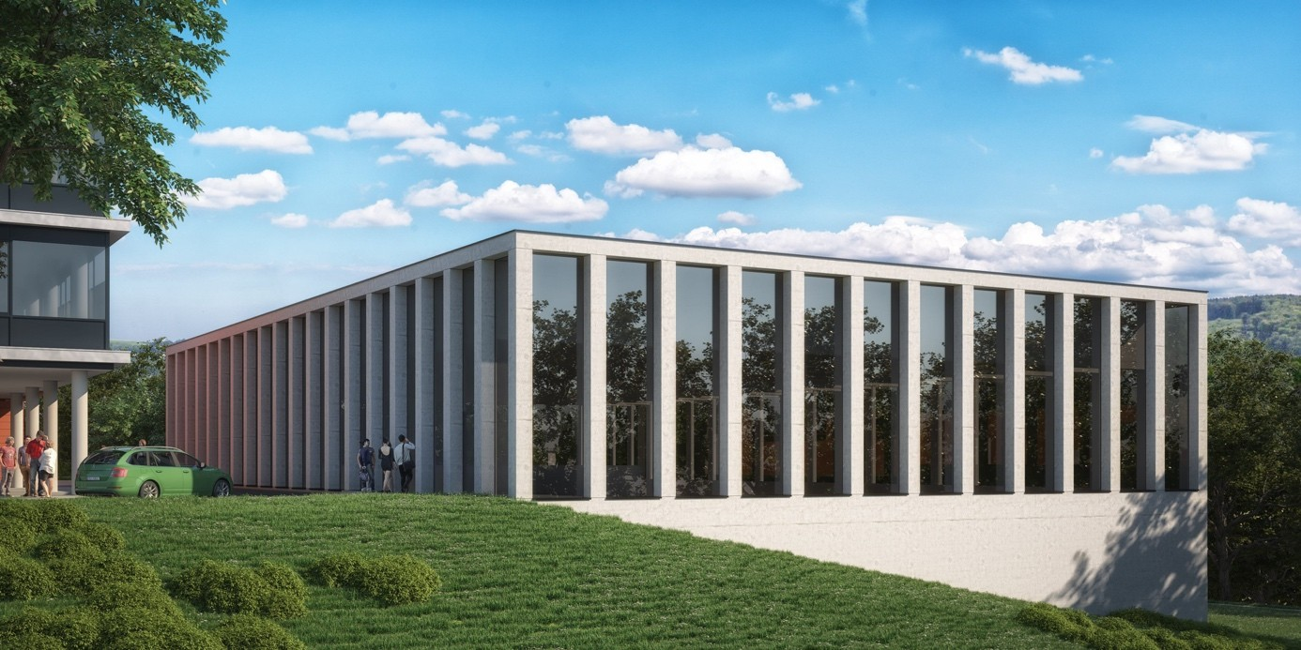
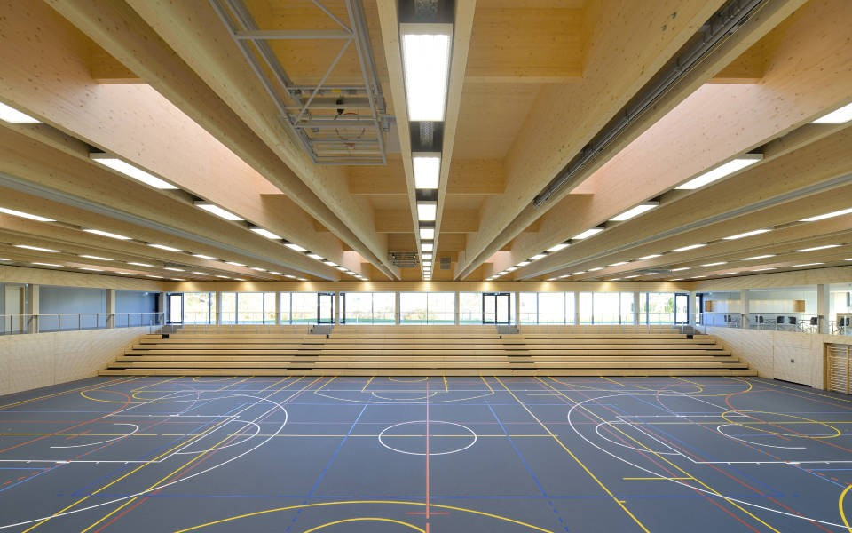
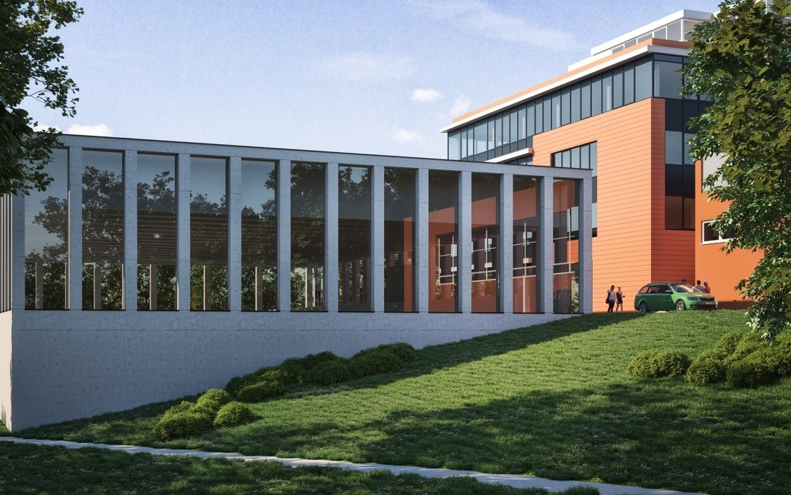
U5 SPORTS HALL · COMMITMENTS TO 2030
U5 multi-purpose sports hall
A multi-purpose indoor sports hall on the U5 campus — for university sport, academic championships and international events.
44 × 22 m
playing area: handball, basketball, volleyball, floorball, tennis
10.5 m
clear height, spectator stand
CZK 150 m
total investment cost excl. VAT
construction; building permit issued 08/2025
Visualisation: UTB investment plan annotation, 01/2026
TOMAS BATA UNIVERSITY IN ZLÍN
14 / 26

Slide 40
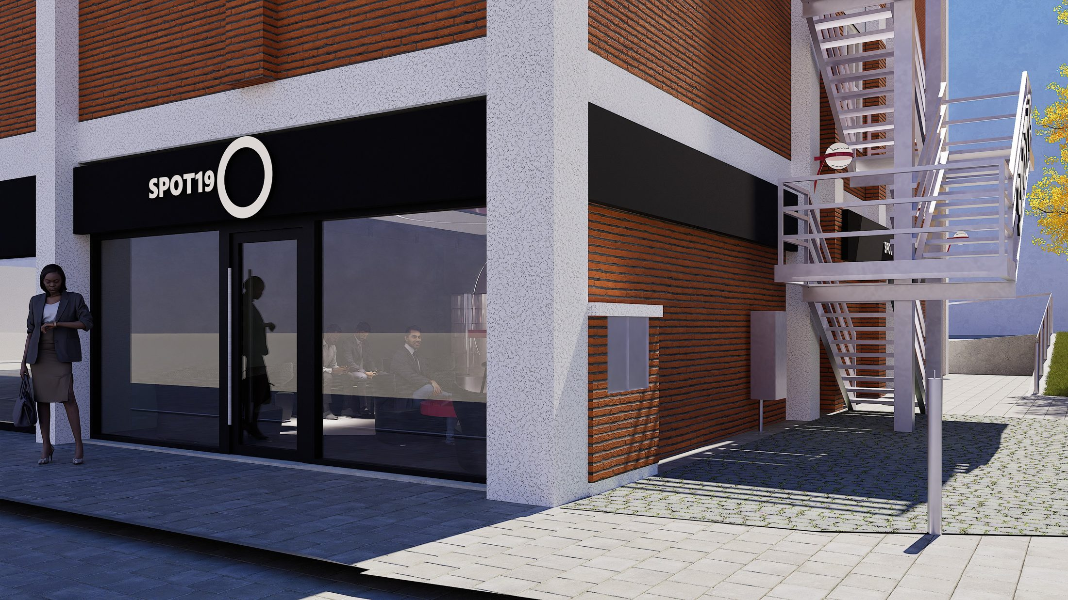
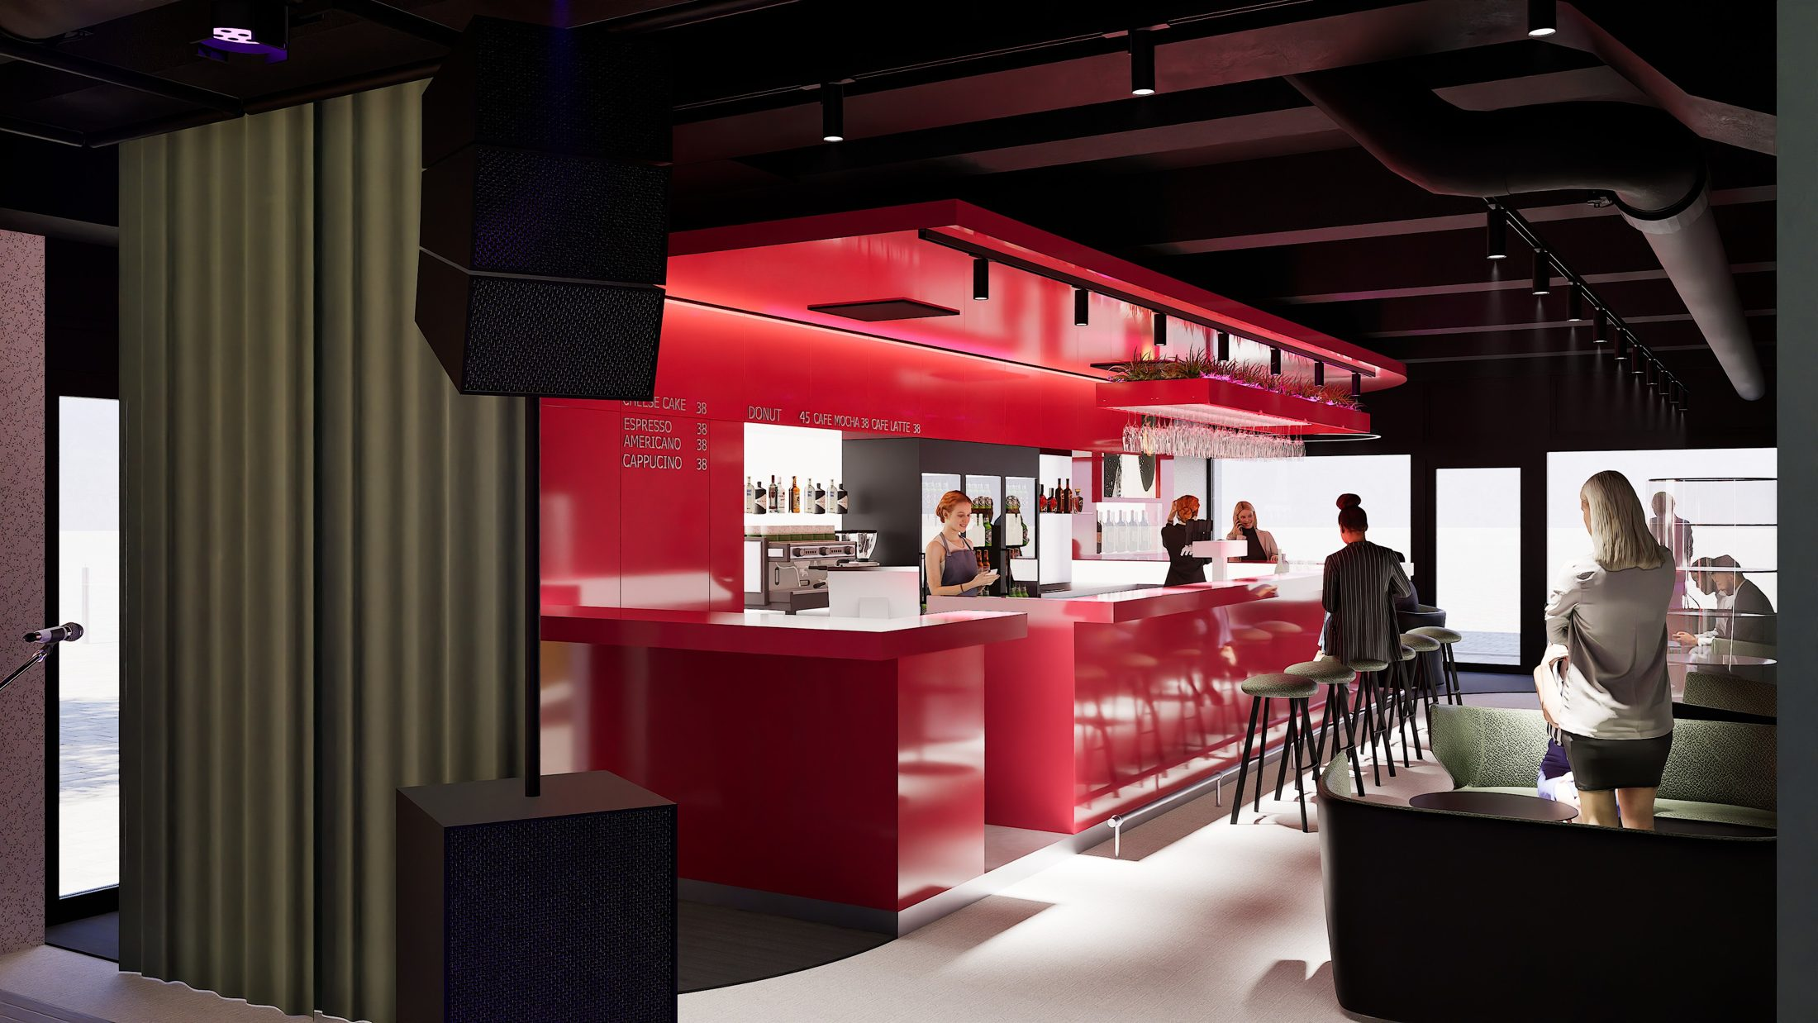
GARNI U19 STUDENT CLUB
SPOT19 — vision for the new club
The concrete form of the commitment to complete the Garni U19 club — a place to meet, a café and a venue for small student events right on campus.
Interior visualisation — café and club concept for students
Part of the 2030 commitments — follows on from “Sports hall and student club”.
TOMAS BATA UNIVERSITY IN ZLÍN
15 / 26

Slide 41
UTB BENCHMARK · SUPPORTING THE INTERNATIONAL CAMPUS
Funding of foreign-language study
UTB's strategic shift: internationalisation beyond the 11,000-student strategy + systematic support for start-ups and spin-offs = an international campus with an investment partner.
TOMAS BATA UNIVERSITY IN ZLÍN
16 / 26

Slide 42

SHARED INFRASTRUCTURE · COMMITMENTS TO 2030
Investing in facilities across UTB
Housing, sport, community life and long-term planning as part of a quality university that attracts new students.
1
2
Sports hall and student club
U3 Růmy dormitory · 158 beds
Secure funding and build the hall between U55 and U5. Complete the renovation and fit-out of the Garni U19 club. Set up stable, efficient operating models for both.
Consider PPP financing only if clearly advantageous and without risk to UTB's financial stability.
3
4
Preparing an international campus in Zlín
Master plan to 2035
Prepare a long-term international campus / university town project with the City of Zlín and the Zlín Region. Deliver only with a strategic investor. Review funding, operation and phasing. Address FMK centralisation and the growth potential of international study at the same time. Supporting data in the chart Funding of foreign-language study.
Prepare an investment master plan to at least 2035. Assess the full building life cycle, use of space, energy and safety.
TOMAS BATA UNIVERSITY IN ZLÍN
17 / 26

Slide 43
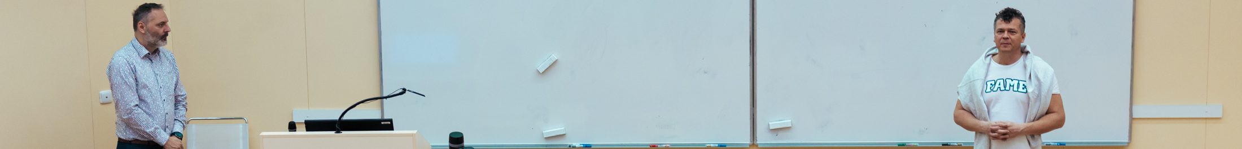
FACULTY AND INFRASTRUCTURE DEVELOPMENT
What matters for the faculties? Commitments to 2030
Investment priorities based on the teaching, research and future needs of each unit.
TOMAS BATA UNIVERSITY IN ZLÍN
18 / 26

Slide 44


FACULTY AND INFRASTRUCTURE DEVELOPMENT
What matters for the faculties? Commitments to 2030
Investment priorities based on the teaching, research and future needs of each unit.
FMK · centralisation
FT · completing U1
FaME · renewing U2
Resolve the fragmentation of workplaces and studios. The new campus (new building) will free up capacity and support FMK's centralisation in central Zlín.
Complete the U1 fit-out and reach full operation in 2027. Tie the investment to the faculty's teaching and research needs.
Prepare the final renovation of U2 systems, fire safety, energy and layout (floors 2–5). Delivery in 2027–2029, subject to funding.
TOMAS BATA UNIVERSITY IN ZLÍN
18 / 26

Slide 45


FACULTY AND INFRASTRUCTURE DEVELOPMENT
What matters for the faculties? Commitments to 2030
Investment priorities based on the teaching, research and future needs of each unit.
FMK · centralisation
FT · completing U1
FaME · renewing U2
Resolve the fragmentation of workplaces and studios. The new campus (new building) will free up capacity and support FMK's centralisation in central Zlín.
Complete the U1 fit-out and reach full operation in 2027. Tie the investment to the faculty's teaching and research needs.
Prepare the final renovation of U2 systems, fire safety, energy and layout (floors 2–5). Delivery in 2027–2029, subject to funding.
FHS · health programmes
FAI · modernising U5/U56
FLKŘ · Uherské Hradiště
Improve conditions for non-medical health programmes. Consider founding a future institute.
Modernise teaching and research facilities in U5 and U56. Align each phase with the university master plan.
Expand and modernise laboratories and teaching and research facilities in Uherské Hradiště.
Link every investment to faculty needs, available resources, strategic partnerships and sustainable long-term operating costs.
TOMAS BATA UNIVERSITY IN ZLÍN
18 / 26

Slide 46
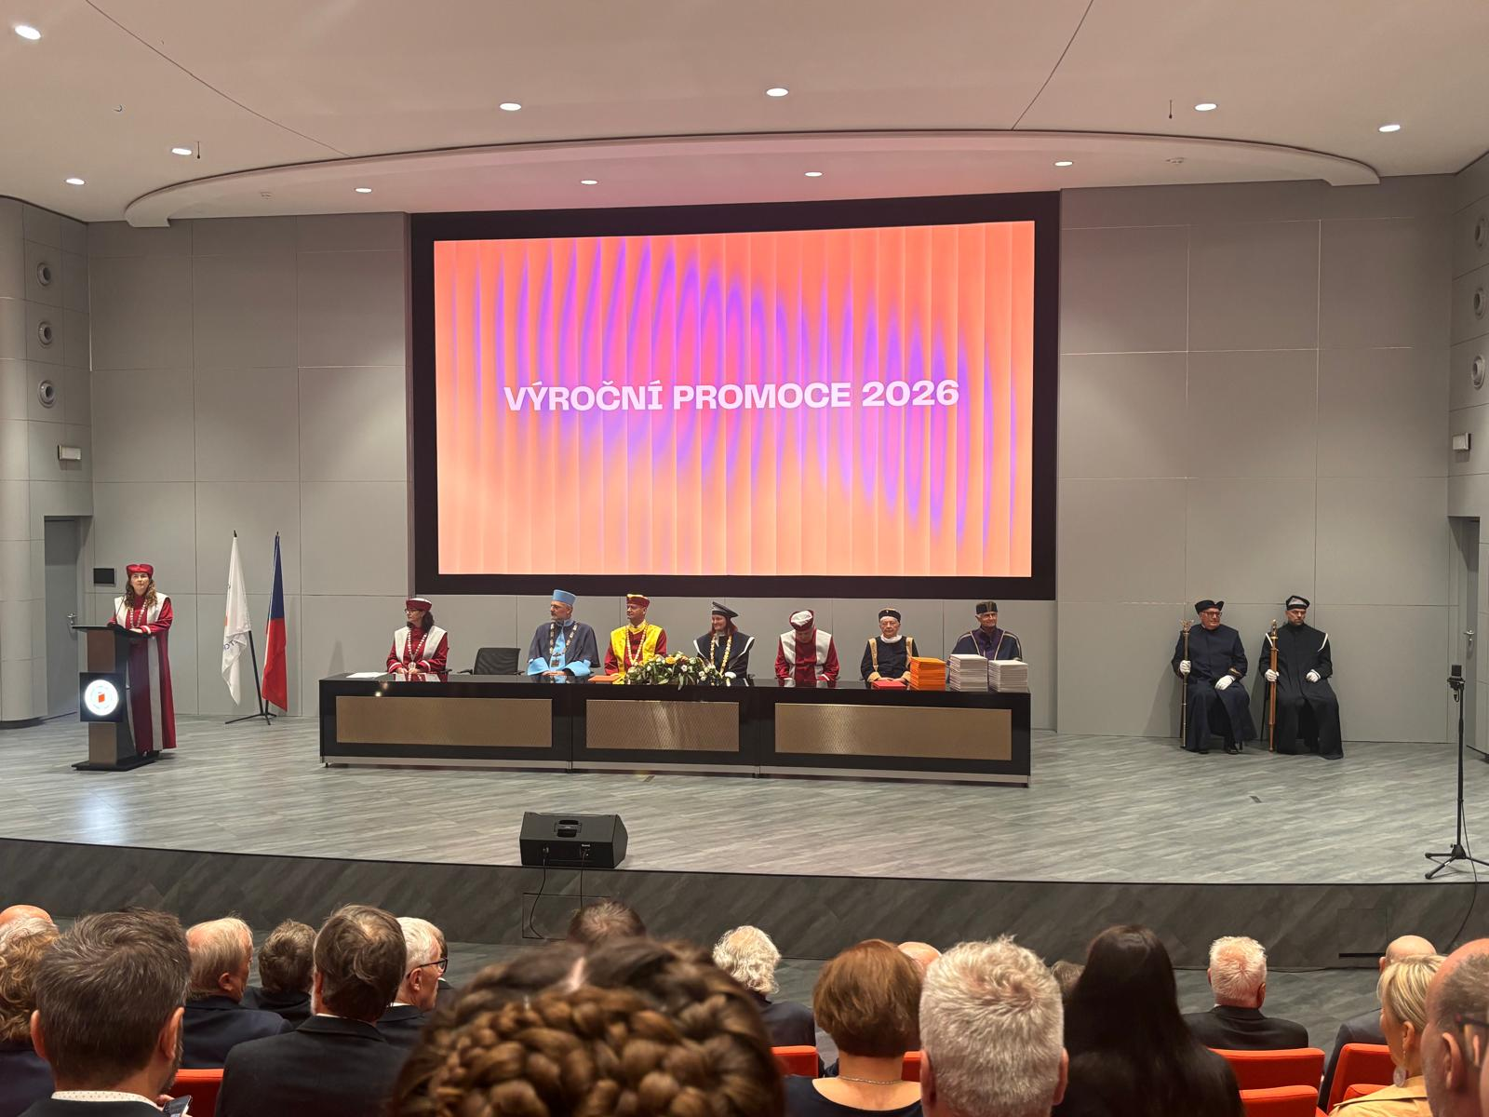
PILLAR 4 · COMMITMENTS TO 2030
AI, digitalisation and a secure university
The university's digital backbone: literacy, data and security as one.
TOMAS BATA UNIVERSITY IN ZLÍN
19 / 26

Slide 47

PILLAR 4 · COMMITMENTS TO 2030
AI, digitalisation and a secure university
The university's digital backbone: literacy, data and security as one.
AI in study and teaching
UTB AI Centre
Build AI literacy into study programmes. Train staff in tools and pedagogy. Set rules for assessment, theses, research and ethics.
Secure supercomputing capacity for AI (teaching, research, transfer). Create an interdisciplinary centre supporting faculties and students.
TOMAS BATA UNIVERSITY IN ZLÍN
19 / 26

Slide 48

PILLAR 4 · COMMITMENTS TO 2030
AI, digitalisation and a secure university
The university's digital backbone: literacy, data and security as one.
AI in study and teaching
UTB AI Centre
Build AI literacy into study programmes. Train staff in tools and pedagogy. Set rules for assessment, theses, research and ethics.
Secure supercomputing capacity for AI (teaching, research, transfer). Create an interdisciplinary centre supporting faculties and students.
Connected systems and services
Security and resilience
Digitise administration, use bank-based digital identity. Unify the data architecture and remove duplicate records.
Strengthen cyber, physical and operational security. Ensure crisis preparedness and business continuity. Drill scenarios regularly and train students and staff.
The Baťa tradition of useful education + a university ready for the next decade.
TOMAS BATA UNIVERSITY IN ZLÍN
19 / 26

Slide 49
PILLAR 5 · COMMITMENTS TO 2030
Entrepreneurial UTB and knowledge transfer
The Baťa tradition commits us to practical impact and the courage to test new ideas.
TOMAS BATA UNIVERSITY IN ZLÍN
20 / 26

Slide 50

PILLAR 5 · COMMITMENTS TO 2030
Entrepreneurial UTB and knowledge transfer
The Baťa tradition commits us to practical impact and the courage to test new ideas.
From idea to application
Supporting founders and long-term partnerships
Create one pathway from IP protection through licensing to start-ups and spin-offs. Open the door to investors.
Connect No Limits Meet Up, UPPER, BarCamp, the Czech Management Association, Garage Angels and alumni. Build a path from idea validation through prototype to first investment. Link practice, theses and contract research.
TOMAS BATA UNIVERSITY IN ZLÍN
20 / 26

Slide 51
PILLAR 5 · COMMITMENTS TO 2030
Entrepreneurial UTB and knowledge transfer
The Baťa tradition commits us to practical impact and the courage to test new ideas.
From idea to application
Supporting founders and long-term partnerships
Students and academics as one team
Create one pathway from IP protection through licensing to start-ups and spin-offs. Open the door to investors.
Connect No Limits Meet Up, UPPER, BarCamp, the Czech Management Association, Garage Angels and alumni. Build a path from idea validation through prototype to first investment. Link practice, theses and contract research.
Support interdisciplinary teams. Involve students as co-authors. Connect creative fields with economics, design and law.
Pillar goal: clear IP rules, legal and financial services, investment readiness and a systematic environment for start-ups and spin-offs across UTB.
TOMAS BATA UNIVERSITY IN ZLÍN
20 / 26

Slide 52
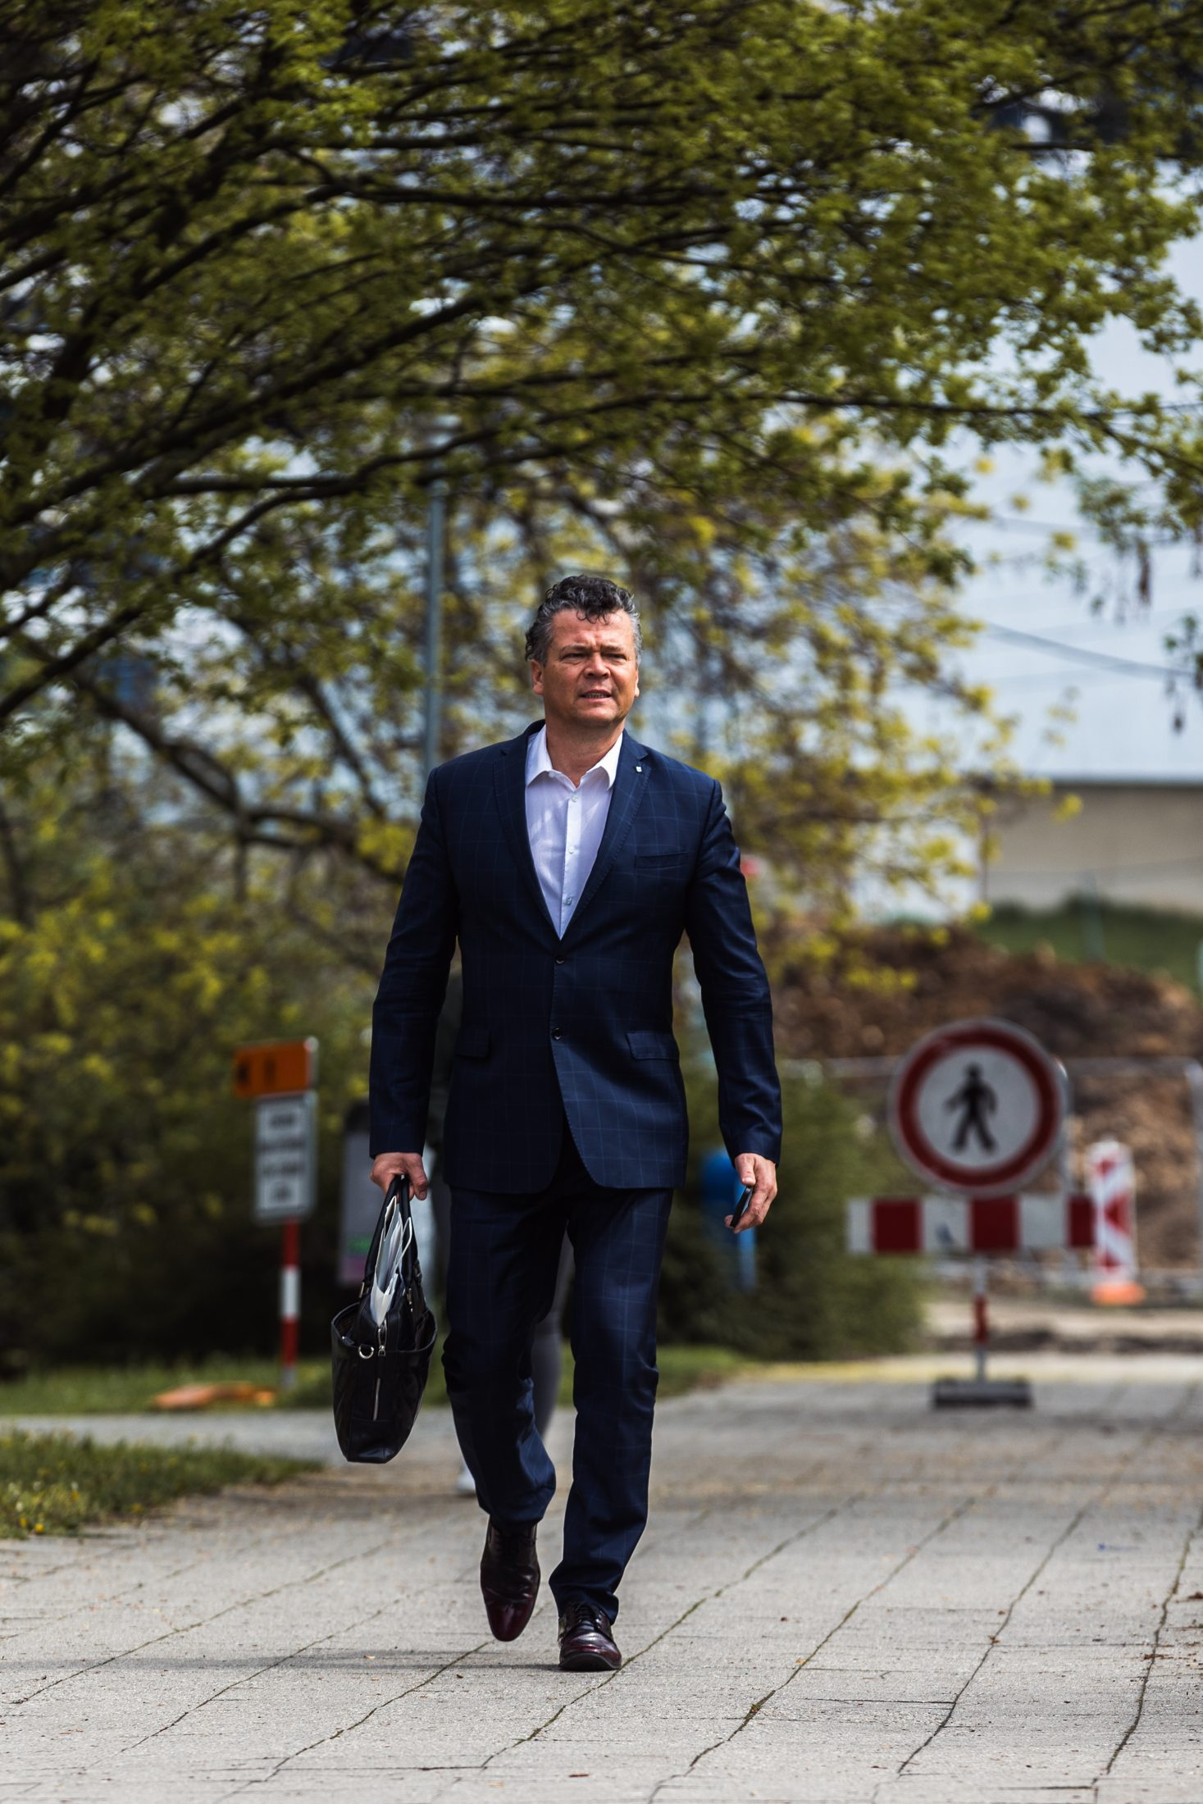
PILLAR 7 · COMMITMENTS TO 2030
Sustainable UTB and the third mission
The university as the engine of the Zlín Region and a partner to public institutions, businesses and citizens.
TOMAS BATA UNIVERSITY IN ZLÍN
21 / 26
21 / 26

Slide 53
PILLAR 7 · COMMITMENTS TO 2030
Sustainable UTB and the third mission
The university as the engine of the Zlín Region and a partner to public institutions, businesses and citizens.
Partner to the region
Develop expertise and joint projects with the region, cities, Tomas Bata Regional Hospital, schools, businesses and NGOs.
AI and innovation for the region
AI testing, consulting and training for SMEs and public services.
TOMAS BATA UNIVERSITY IN ZLÍN
21 / 26
21 / 26

Slide 54
PILLAR 7 · COMMITMENTS TO 2030
Sustainable UTB and the third mission
The university as the engine of the Zlín Region and a partner to public institutions, businesses and citizens.
Partner to the region
Develop expertise and joint projects with the region, cities, Tomas Bata Regional Hospital, schools, businesses and NGOs.
AI and innovation for the region
AI testing, consulting and training for SMEs and public services.
Sustainability and a living lab
A sustainability plan to 2030: energy, emissions, waste, water, mobility and responsible procurement. Use the results in teaching, research and theses.
UTB helps the region
Volunteering — meaningful help where it is needed. University of the Third Age. Science outreach.
TOMAS BATA UNIVERSITY IN ZLÍN
21 / 26
21 / 26

Slide 55
CLOSING COMMITMENT
A UTB that students, graduates and staff can be proud of.
Quality education · free and responsible research · professional growth · cooperation with the region and the world · tangible social and economic impact.
Let's take UTB higher — TOGETHER

Slide 56
THANK YOU
Allow me to say thank you.
Thank you for your attention.
Thank you for the opportunity to present my programme here.
Thank you for letting me be part of the UTB community — my professional family.
Thank you to my family for their support and love.
Thank you that I can sometimes fly above the clouds and see the world from above.
I am truly glad to have you.

Slide 57


STARTING POINT
UTB faces a decisive period
Demographics, the spread of AI, the labour market and pressure on accreditation — the need to transform and streamline programmes, plus international competition — call for clear priorities and clear steps.
Transforming teaching
The rise of AI
The future of education in new accreditations: AI in courses, a focus on quality, common first years, stronger project-based teaching with companies.
An AI Centre as a cross-cutting competence for students and academics — paid licences for work and administration, simpler and cleaner processes.
Pressure on quality
Zlín Region
The impact of teaching, research and the third mission must be visible.
A partner to businesses, schools, hospitals and public administration, including joint projects.
I do not see this election as a contest, but as an important milestone that can set UTB's direction better and ultimately lead to better results.
TOMAS BATA UNIVERSITY IN ZLÍN
24 / 26

Slide 58

PROGRAMME IMPACT
What students, academics and the region gain
Three groups, one shared direction for UTB.
Students
Academics and staff
The region and partners
Better study, placements, projects, international experience, wellbeing and, above all, a livelier campus with long-term prospects.
Time for expert work, career growth, recognition of teaching, connected support services and a safe environment.
Population growth in the region, an international campus, AI capacity, start-ups/spin-offs, investment, lifelong learning and solutions to real problems.
A university for students, academics, the region and the future — open to the world, capital, technology and new companies.
TOMAS BATA UNIVERSITY IN ZLÍN
25 / 26

Slide 59
LEADERSHIP PRINCIPLES
A strategy with a clear investment plan
Less formalism. More trust, service and results.
Respect for faculties
Trust and accountability
The Rector's Office uses process thinking and best practice — it serves, respects faculty autonomy, unifies standards and data, and does not centralise further.
Open communication, a predictable environment and clear responsibilities for students and staff.
Measurable without formalism
Partnership, not isolation
Every priority has an owner, a timeline and meaningful indicators defined in advance.
Connect faculties and, more strongly, graduates, the region, businesses, public administration and international partners.
TOMAS BATA UNIVERSITY IN ZLÍN
26 / 26

